Slide 1
Comment on the renormalization of absolute alpha-particle energies
Daniel Abriola
Tandar Lab.
Buenos Aires, Argentina

Slide 2
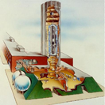
Outline
Renormalization of absolute measurements of α-particle energies (re-analyzed)
Check of 144-Sm datasets
Spectrometer measurements
Fundamental constants
Renormalization of old data
Conclusions
TANDAR

Slide 3
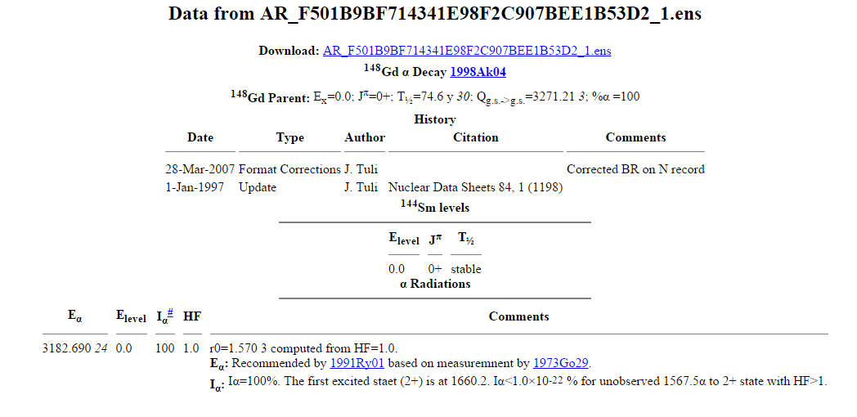
TANDAR

Slide 4
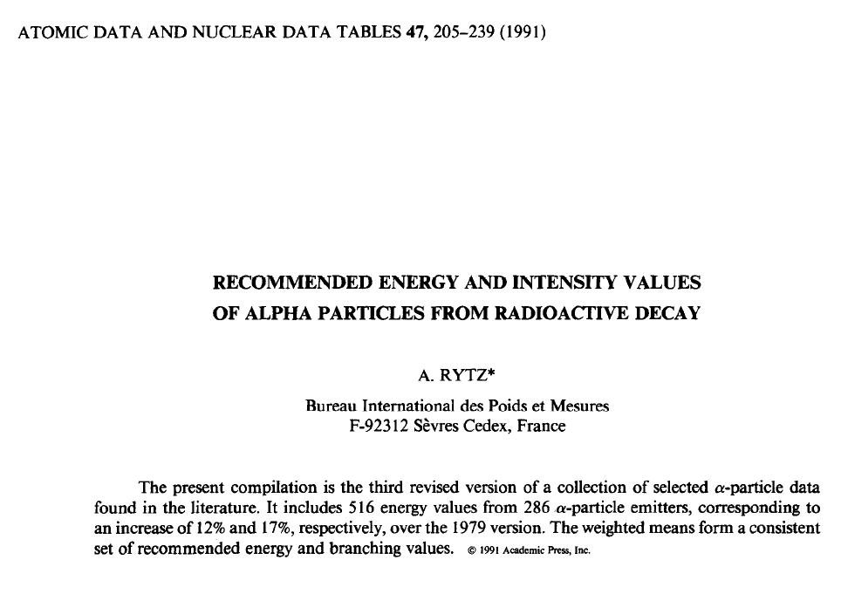
1991RY01
TANDAR

Slide 5
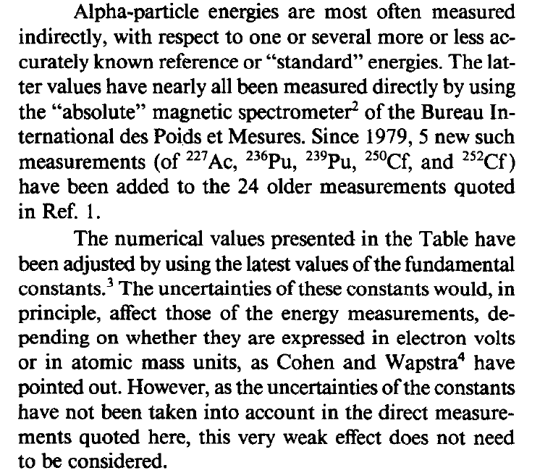
1991RY01
Not explained
TANDAR

Slide 6
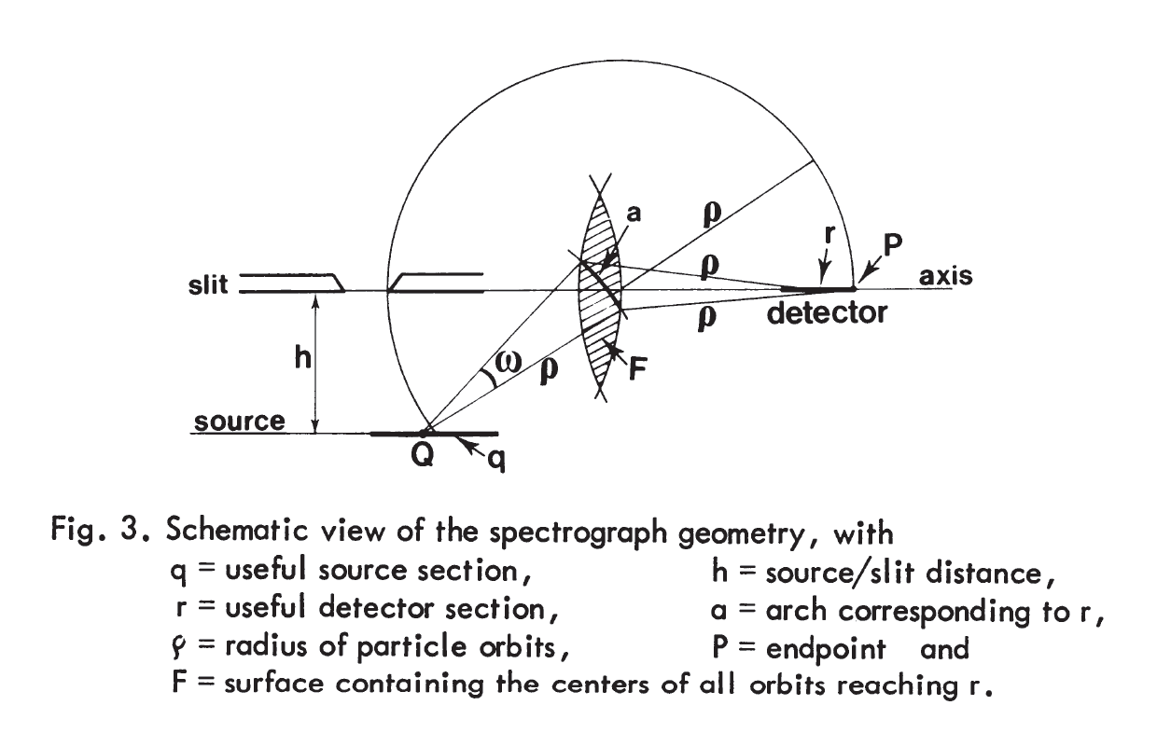
1980RYZX
H: Magnetic field
H= H´/γ
H´: measured by NMR
TANDAR

Slide 7
1991RY01
TANDAR

Slide 8
Βρ = p/q
^{Non-relativistic energy} ^{formula:}
E´= q²/m_{α} (Βρ)²
^{Relativistic formula:}
TANDAR

Slide 9
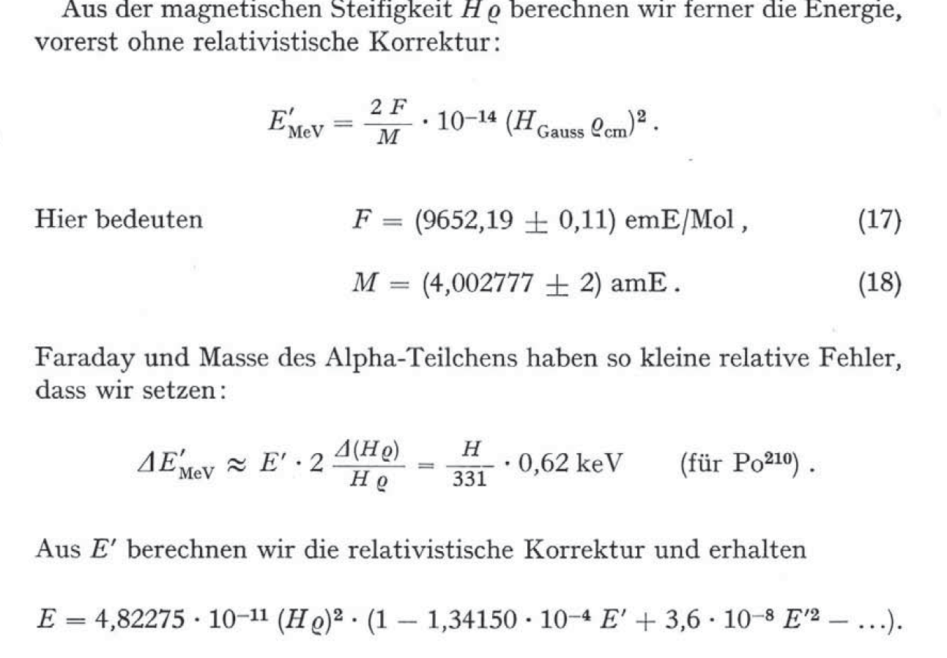
1961RY02
a
TANDAR

Slide 10
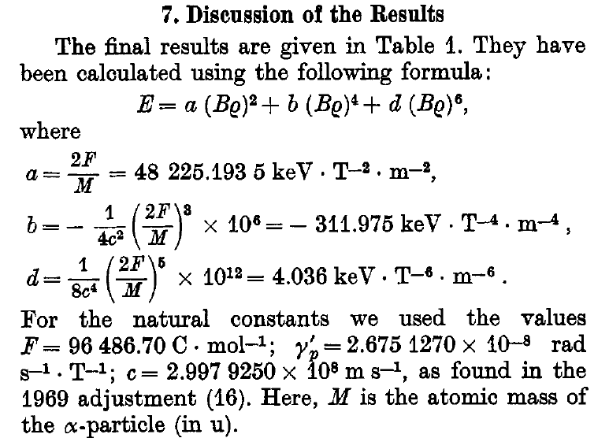
1971GR17
TANDAR

Slide 11
E = E´ (1+ b/a (Βρ)²+ d/a (Βρ)⁴
E = E´ (1+ b/a² E´+ d/a³ E´²)
E = E´ (1- a/4c² 10⁶ E´+ a²/8c⁴ 10¹² E´²)
TANDAR

Slide 12
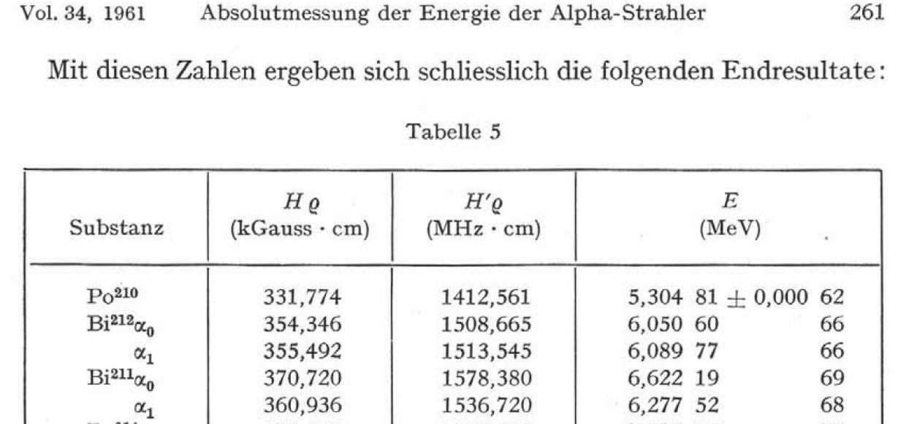
Relativistic
H= H´/γ
E´= a.(Hρ)²
TANDAR

Slide 13
E´)₁₉₆₁= a/γ²)₁₉₆₁ (νρ)²
For the same measurement now
E´)₂₀₁₅= a/γ²)₂₀₁₅ (νρ)²
To renormalize 1961 data to 2015 values of FC:
E´)₂₀₁₅= a/γ²)₂₀₁₅/ a/γ²)₁₉₆₁ E´)₁₉₆₁
Correction factor: f
TANDAR

Slide 14
Actual value from 1961Ry02 f=0.33696
(off-scale) gives -2.33 keV correction!
TANDAR

Slide 15
Parent | E (Original) | Ref | E(1991Ry01) | Adj. | This Work Adj. | This Work Energy
148-Gd | 3182.787(24) | 73GO | 3182.680(24) | -0.107 | -0.1055 | 3182.682(24)
210-Po | 5304.51(7) | 73GO1 | 5304.33(7) | -0.18 | -0.1752 | 5304.33(7)
211-Bi | 6622.19(69) | 61Ry |  | -0.52 | -2.33 -0.225(1961Ry05)
 | 6623.1(6) | 71Gr | 6622.9(6) | -0.2 | -0.221 | 6622.4(6)w.a.
216-Po | 6778.5(5) | 71Gr | 6778.3(5) | -0.2 | -0.226 | 6778.3(5)
212-Bi | 6090.06(8) 6090.087(37) | 69Gr 72Go | 6089.879(34) | -0.20 -0.204 | -0.203 -0.203 | 6089.879(34)
TANDAR

Slide 16
1991RY01
1961RY02
TANDAR

Slide 17
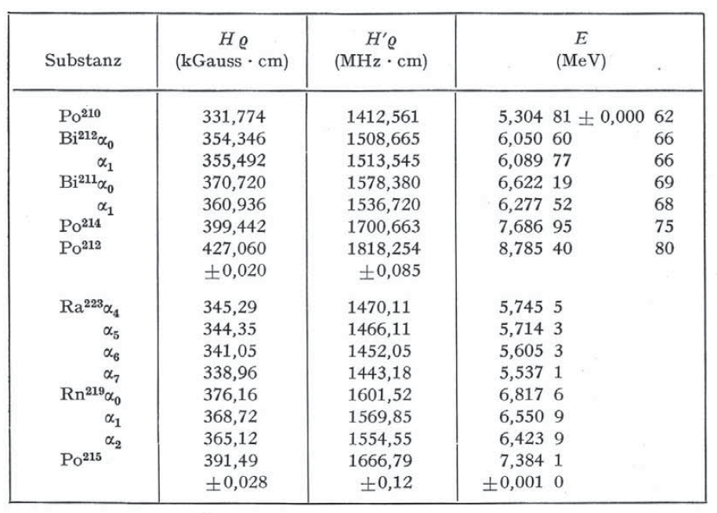
1961RY02
Not used in 1991RY01
6621.85
6277.20
7686.60
8785.01
TANDAR

Slide 18
Conclusions
Absolute alpha-particle energies were renormalized to 2015 values of FC.
For 148Gd->144Sm 3182.680(24)->3182.682(24)
For most energies (28-4) change is negligible (≈1 eV)
Data from 1961Ry02 ad hoc normalization?
TANDAR

Slide 19
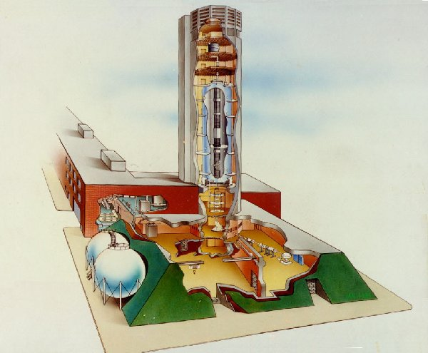
Thank you!
TANDAR

